Slide 1
Automated Relationship Analysis on Requirements Documents: An Introduction to Some Recent Work
6.29

Slide 2
Outline
Background
Recent Work (Type 1)
Recent Work (Type 2)
Inspirations

Slide 3
Background
According to a “Market Research for Requirement Analysis using Linguistic Tools” (Luisa M. et al., RE Journal, 2004) → 71.8% of requirements documents are written in unconstrained natural language
However, most activities in RE and its later stage rely on requirements models or even formal specifications

Slide 4
Keywords
Requirements Documents (Input)
Any textual materials related to requirements, written in natural language (English)
Relationship (Output)
Specific relationships between the requirements items (or simply “the requirements”)
Automated Text Analysis
Statistical Approach
Linguistic Approach

Slide 5
Statistical vs. Linguistic
Statistical approaches analyze text based on probabilities
Keywords: frequency, similarity, clustering, …
Linguistic approaches analyze text based on the syntax and semantics of words
Keywords: part-of-speech, ontology, word net, …

Slide 6
Outline
Background
Recent Work (Type 1: Statistical Approaches)
Recent Work (Type 2)
Inspirations

Slide 7
Work #1
A Feasibility Study of Automated Natural Language Requirements Analysis in Market-Driven Development
J. Natt och Dag et al. (Sweden), RE Journal, 2002
Which relationship?
Similar / Dissimilar
Pros
A carefully designed experiment

Slide 8

Background
In Telelogic Techs AB (a famous CASE company in Sweden), the requirements are collected like this
Quality Gateway
Requirements Candidates
Completeness Analysis
Approved
Requirements Database
Ambiguity Analysis
Requirements Engineer
Issuer
Request for Clarification
Similarity Analysis
The paper focuses on automating this

Slide 9
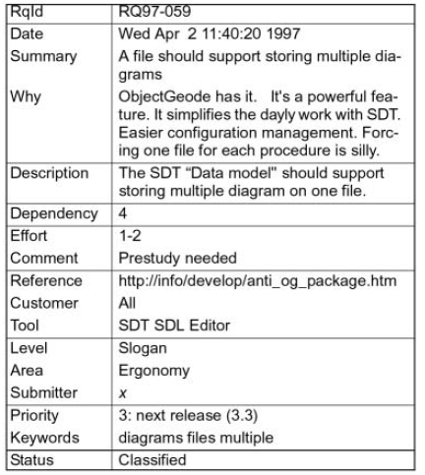
The Form of Requirements
Only process summary and description

Slide 10
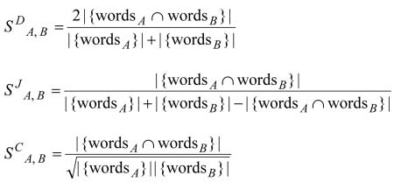
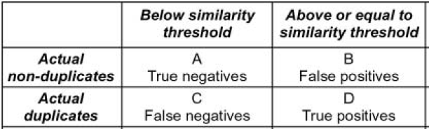
The Similarity
3 methods for calculating similarity of requirements A and B
Given a similarity threshold, the quality of methods is assessed as:
(Dice)
(Jaccard)
(cosine)
Accuracy =
(A+D) / (A+B+C+D)

Slide 11
Empirical Study: Data Preparation
Full Set: 1891 requirements from Telelogic AB company, with status being tagged
New, Assigned, Classified, Implemented, Rejected, Duplicated
Reduced Set: already analyzed requirements
All: classified, implemented, rejected, duplicated
Priority = 1: new, assigned
1089 requirements

Slide 12
Experiments
3 similarity methods
2 sets (full, reduced)
3 fields
Summary only
Description only
Summary + Description
9 similarity threshold
0, 0.125, 0.25, 0.375, …, 1
Totally 3*2*3*9 = 162 experiments

Slide 13
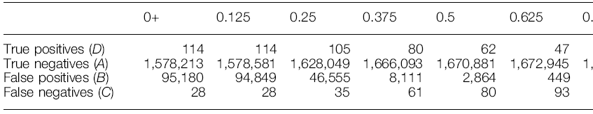
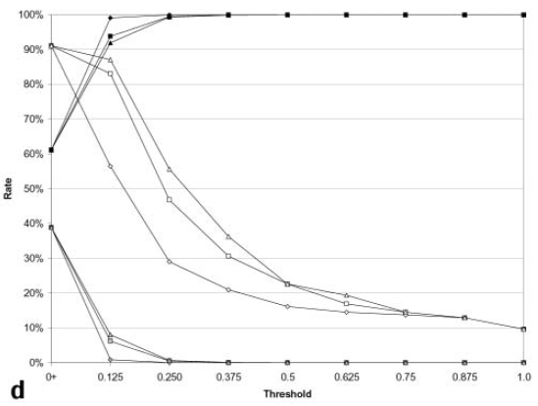
Results (Example)
Field = Summary, Method = Cosine, Set = Full
Threshold
Field = Summary + Description, Set = Reduced
Accuracy (of 3 methods)
True Positive (of 3 methods)
False Positive (of 3 methods)

Slide 14
Extra Evaluation
Does human miss duplicates?
Give the experts 75 False Positives under {method = cosine, threshold = 0.75, set = full, field = Summary}
28 are True (i.e. previously missed by human)

Slide 15
Summary
Gives reasonably high accuracy
Dice and cosine methods give better results
A large textual field (Description) tends to give worse results; it should only be used when the Summary field contains too few words

Slide 16
Work #2
Towards Automated Requirements Prioritization and Triage
C. Duan, Cleland-Huang, RE Journal, 2009
Which Relationship?
Ordering
Pros
An interesting idea based on a deep thought of the nature of requirements

Slide 17
Basic Idea
The basic idea is to reduce human work by asking people to prioritize dozens of requirements clusters instead of thousands of individual requirements
Auto
Manual
Auto
…
Individual Requirements
Requirements Clusters
Sorted Clusters
Sorted Requirements

Slide 18
What makes it interesting?
The nature of requirements: An individual requirements often plays a complex and diverse role. For example:
An individual requirements may address both functionality and NFR needs.
An individual requirements may involve several functionalities.
How to take it into account?

Slide 19
The Proposed Approach
Multiple Orthogonal Clustering Criteria
Repeat the “Basic Idea” multiple times, for each time the clustering criteria is different.
Clustering criteria
Similarity with each other (Traditional clustering)
Similarity with predefined text, such as: NFR indicator words, business goals, main use cases
Fuzzy Clustering: an individual requirements has various degrees of membership to each cluster

Slide 20
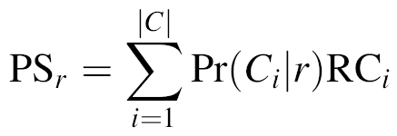
Clustering 1: Traditional
1. Similar requirements form a cluster
Cosine method for similarity calculation
2. Manually assign a score RC for each cluster
3. Similarity between each requirement r and cluster Ci, denoted as Pr(Ci|r)
4. Final score for each requirement:
C is the set of clusters.

Slide 21
“Clustering” with Pre-defined Clusters
0. Each pre-defined cluster is described in text (e.g. business goal description, use case, NFR indicator words)
1. “Clustering” is done by computing similarity between requirements and cluster text, but only top X% similar ones are valid.
Reason: NOT all requirements are related to these concerns.
2 – 4. Remains the same.

Slide 22
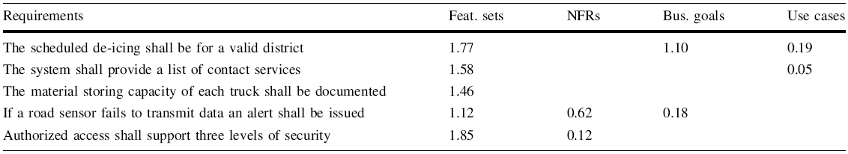
An Example
Traditional
Blank means not related

Slide 23
Final Step: Combine the Scores
1. Manually assign weights to each clustering criteria.
2. Final score is the weighted sum of scores under each criteria.
0.5
0.2
0.3
Score of first requirements = 1.77 * 0.5 + 1.1 * 0.3

Slide 24
Evaluation in Requirements Triage
Requirements Triage: Decide which requirements should be implemented in next release.
It is the purpose of prioritization.
5 levels: Must have, recommend having, nice to have, can live without, defer
Top 20% priority → Must have, next 20% → Recommend having, …
Results (202 requirements)
Inclusion Error (false important): 17%
Exclusion Error (false non-important): <2%

Slide 25
Outline
Background
Recent Work (Type 1)
Recent Work (Type 2: Linguistic Approach)
Inspirations

Slide 26
Work #3
Formal Semantic Conflict Detection in Aspect-Oriented Requirements
N. Weston, A. Rashid. RE Journal, 2009
Which relationship?
Conflict

Slide 27
Background
Aspect-oriented requirements (AORs): Separated requirements for each concern
Concern: Customer
Req 1: The customer selects the room type to view room facilitates and room rates.
Req 2: The customer makes a reservation for the chosen room type.
Concern: CacheAccess
Req 1: The system looks up cache when:
1.1: room type data is accessed;
1.2: room pricing data is accessed.

Slide 28
Background
Requirements of different concerns are composed together, traditionally, in a syntactic way.
Conflict detection: Requirements (Base) constrained by multiple aspects are possible places of conflicts.
Composition:
Aspect name = “CacheAccess”, req id = “all”
Base name = “Customer”, req id = “1”
Constraint action = “provide” operator = “for”
Rely on reference name or ID

Slide 29
Semantic AOR
The sentences in requirements are tagged with linguistic attributes
It can be done by tools like WMatrix
The customer selects the room type to view room facilitates and room rates.
Subject
Object
Object
Object
Relationship: type = “Mental Action”, semantics = “Decide”

Slide 30
Semantic Composition
Query matches one or more requirements
Composition: AccessCache
Aspect Query: relationship = “look up” AND object = “cache”
Base Query: subject = “frequently used data” OR object = “frequently used data”
Outcome Query: relationship = “update” AND object = “cache”
Constraint: aspect operator = “apply”
base operator = “meets”
outcome operator = “satisfied”
Time
Interpretation: The aspect requirements (look up cache) happens just before (meets) the access of frequently used data, the result must satisfy the requirements dealing with update cache.

Slide 31
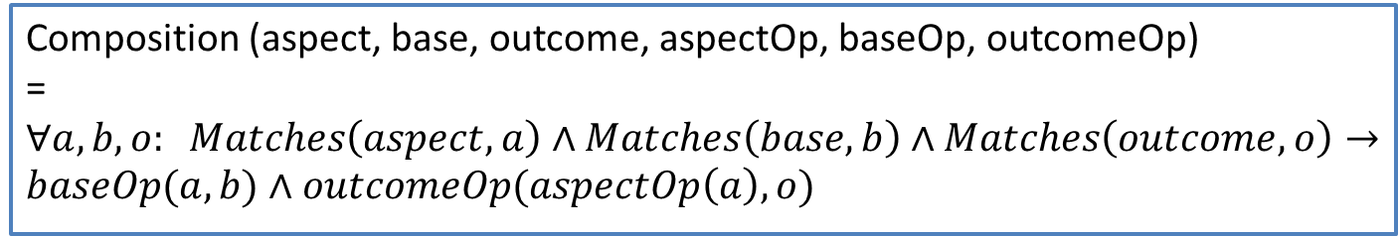
Formalize the Composition
Convert the queries and operators into first order temporal logical formula, the generic form is:
Interpretation: apply the aspect to base under the condition of baseOp; while ensuring that the aspectOp is correctly established and the conditions of outcome are upheld.
Composition (aspect, base, outcome, aspectOp, baseOp, outcomeOp)
= $∀a, b, o: Matches\left(aspect, a\right)∧Matches\left(base, b\right)∧Matches\left(outcome, o\right)→baseOp(a, b)∧outcomeOp(aspectOp\left(a\right), o)$

Slide 32
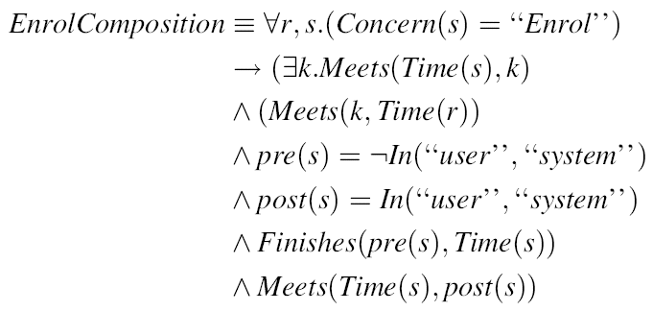
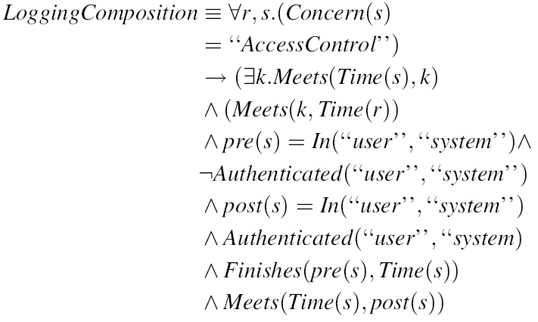
Example
Time

Slide 33
Formal Conflict Detection
The conflicts are possible if there is temporal overlap between compositions
Use a theorem prover to find logical conflicts
However, only those with the same predicates can be found automatically

Slide 34
Example: Conflicts in Enroll and Log-in Compositions
In the conjunction of the two compositions, we can deduce that
Therefore a conflict is detected.
Reason: EnrollComposition states that “Enrollment happens before everything”; while LoginComposition also states that “Login happens before everything”.
Resolve the conflict: change the composition to “Login happens before everything except Enrollment”

Slide 35
Discussions
Not a solution for detection or resolution of all potential conflicts
Relies on the quality of requirements text (the level it can be correctly annotated)
Need capturing domain-specific semantics of common verbs
E.g. “affiliate” can be “joining a group (enroll)” or “log in a group”
Scalability is improved by the assumption of temporal overlap
Full automation is impossible
Much harder to implement comparing to statistical approaches

Slide 36
Outline
Background
Recent Work (Type 1)
Recent Work (Type 2)
Inspirations

Slide 37
A Way to Co-FM
User inputs a name and a description of a feature
Automated Analysis (2)
Automated Analysis (1)
New constraints may be discovered, or;
Existing constraints are now discovered improper
The feature is either
Merged with one or more existing features, or;
a new feature, with recommended parent
With the above help, the user may revise the constraints
With the above help, the user places the feature into the system

Slide 38
Other Inspirations
“Constraint Keyword” may be similar to the idea of “NFR indicator words” in the work #2
A mixed approach may be prefer because, at least, the semantics of the verb is significantly related to the constraints

